Slide 1
MACHINE TRANSLATION & SPEECH RECOGNITION
Presented by :K.Jahnavi
(212U1A3348)

Slide 2
contents
Introduction
Machine translation
Types of machine translation
Applications
Speech recognition
Types of speech recognization
Advantages, disadvantages
conclusion

Slide 3
INTRODUCTION
Machine translation is a subfield of artificial intelligence (AI) and computational linguistics that focuses on the automatic translation of text or speech from one language to another.
Types of Machine Translation:
Rule-based systems rely on linguistic rules and dictionaries to perform translations, while statistical systems analyze large corpora of bilingual texts to generate translations based on statistical patterns.
Neural machine translation, which is the most prominent approach today, employs deep learning models, such as recurrent neural networks (RNNs) or transformer models, to learn the mapping between languages directly from data.

Slide 4
Machine translation
Machine translation (MT) refers to the use of computer algorithms and technology to automatically translate text or speech from one language to another. It aims to bridge the language barrier and enable communication between people who speak different languages.
The process of machine translation involves several steps:
Preprocessing : The input text is analyzed and prepared for translation.
Parsing and Analysis: The source text is analyzed to understand its grammatical structure, syntax, and semantics.
Translation Model: The translation model is the core component of machine translation.

Slide 5
Post processing : After generating the initial translation, post processing techniques can be applied to improve the quality.
Evaluation: The quality of the machine translation output is assessed through various evaluation metrics, such as BLEU (Bilingual Evaluation Understudy) or human evaluation.
Machine translation has made significant advancements in recent years, primarily driven by the development of neural machine translation models. These models have shown improved translation quality, especially for complex and context-dependent languages.
However, machine translation still faces challenges, such as handling rare or ambiguous words, capturing idiomatic expressions, and understanding nuanced cultural and contextual references.

Slide 6
Types of machine translation
Rule-Based Machine Translation (RBMT): RBMT systems use linguistic rules and dictionaries to perform translations. These rules are developed by linguists and language experts, and they define the grammar, syntax, and vocabulary of both the source and target languages
Statistical Machine Translation (SMT): SMT systems use statistical models to learn the translation patterns from large bilingual corpora. These models analyze the statistical properties of sentence alignments and phrase translations to generate translations.
Neural Machine Translation (NMT): NMT is the state-of-the-art approach in machine translation. NMT models employ deep neural networks, such as recurrent neural networks (RNNs) or transformer models, to learn the translation mappings directly from data. These models take into account the entire context of a sentence and have the ability to capture long-range dependencies.

Slide 7
Applications
Content Translation
Information Retrieval
Content Translation
Cross-Language Communication
Language Preservation

Slide 8
Speech recognization
Speech Recognition is the technology that converts spoken language into written text.
It enables voice commands, transcription services, and hands-free interactions with digital devices.
Speech recognition systems use automatic speech recognition (ASR) techniques, often combined with natural language processing (NLP) algorithms.

Slide 9
Where it can be used?
System control/navigation
E.g. GPS-connected digital maps:”How far is it to the motorway junction?”
Commercial/industria applications
in car steering systems.

Slide 10
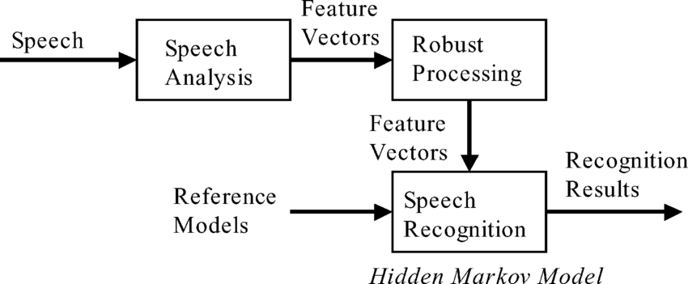

Slide 11
Advantages
Increaseaes productivity.
Can help withmenial computer tasks,such as browsing and scrolling.
Has long term benifits for students.

Slide 12
Disadvantages
Can be hacked with pre recorded verbal messages.
Has an initial period of of adjusting to each users voice.
Can be distracted in a cubicle environment.
Less accurate when there is a background noise.

Slide 13
conclusion
Machine Translation and Speech Recognition technologies are revolutionizing communication in today's globalized world.
These technologies break down language barriers and facilitate seamless cross-cultural interactions.
As they continue to evolve, we can expect improved accuracy and wider adoption, benefiting individuals and businesses worldwide.

Slide 14
THANK YOU

